Slide 1
Version Control
Tracking and controlling changes to Your code

Slide 2
What is Version Control?
The practice of tracking and managing changes to code
Also known as source control
Can be used as an individual or by a team
Usually facilitated through a version control system (VCS) / source code management system (SCM), e.g.:
Git
Subversion
These systems let you control changes to the code over time
Track changes
Accept/reject changes
Merge the work of separate developers

Slide 3
How Version Control Works
All code is kept in a shared repository
Repository stores the current version of the source code files
Repository also stores all previous versions of the files
If something goes wrong, you can roll back to a previous version.
Developers in a team can work on separate copies of the code
Make their changes away from the main project – no impact on others
Merge the update back in when they are happy with it
Code must be checked before it is merged into the main project
Flawed and/or conflicting code can be found, assessed and adjusted before being accepted
Notes:
Useful resource: https://homes.cs.washington.edu/~mernst/advice/version-control.html

Slide 4
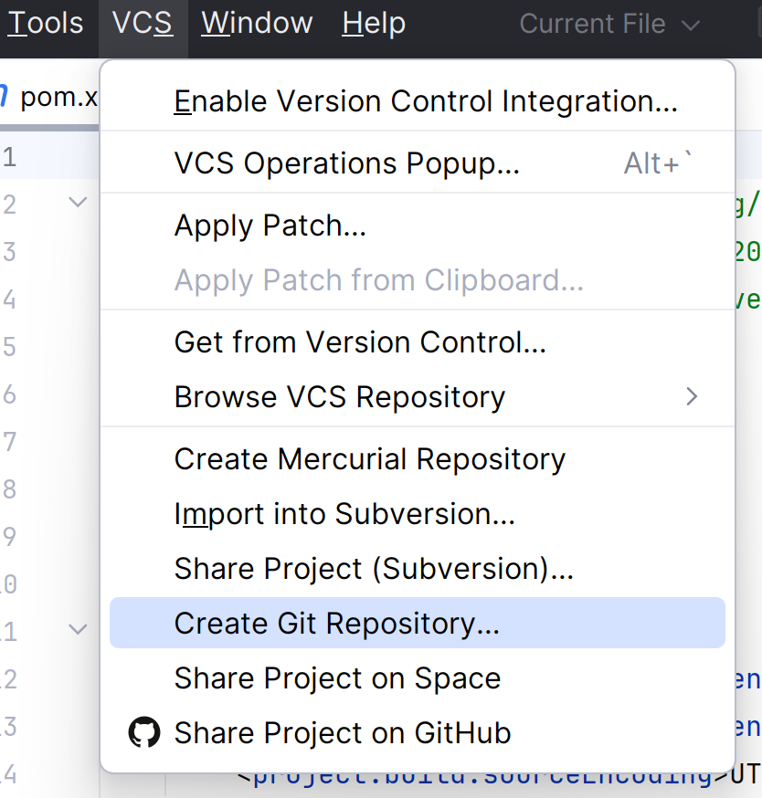
IDEs & Version Control
Most IDEs have version control tools built in
You can use these tools on the command line, but we’ll focus on the IDE-integrated ones
IntelliJ keeps the options to set up version control in the VCS menu of the menu bar.

Slide 5
Wait, Which VCS?
To use version control, you need a version control system (VCS)
VCS lets developers manage their repository/repositories
Different systems do things slightly differently – we will focus on Git
We’ll discuss the general concepts, but the details are specific to Git
Why Git?
One of the most popular version control systems; an industry standard
Employs a distributed approach
Git is hosted online through a number of sites, we’ll be using Github

Slide 6
Different Scenarios for Project Set Up
Sometimes you will start by initialising the project
This happens primarily on solo work
Sometimes you will need to start working on an existing project, e.g.:
Starting work on a new team
Where your teammate creates the initial project
Where you are working on a new machine

Slide 7
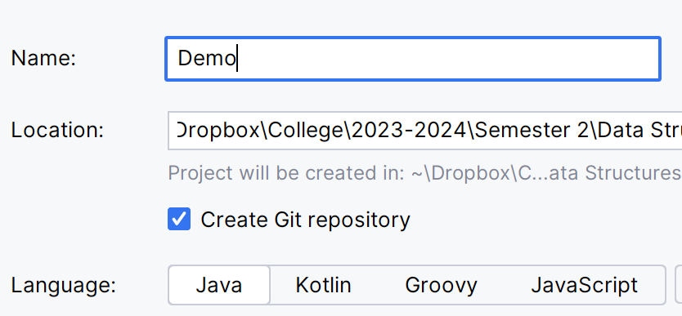
Stage 1) Creating a Git Repository for Your Project
The easiest way to set up git on your project is from the very beginning
Done when you create the project
Benefit of this approach:
IntelliJ will ask if you want to add each new file to the list of git-monitored files
You’ll have them offered as options for inclusion in commits

Slide 8
In Pictures: Adding a Git Repository to a Project
Before adding a repository:
After adding a repository (repo):
Code + History in Snapshots
Project: Code saved in IDE
Project: Code saved in IDE
Project exists
Project (working copy) still exists
Git repository ALSO exists

Slide 9
Stage 1) (Alternative) Adding a Git Repository to a Project
You can also add a repository to an existing project:
Menu -> VCS -> Create Git Repository
Useful if you have forgotten to add one or decide to add git later
Downside to this approach:
You won’t be prompted to add new files to the “git-monitored” set

Slide 10
Stage 2) Setting Up Boundaries
Software projects are not just made up of source code files, they also include:
Libraries
Jars/wars
Etc
Tracking these (keeping multiple copies over time) just results in bloated, wasteful repositories
To avoid this, we can use an ignore file (e.g. gitignore)
Specify file types and even specific directories to leave out of our repositories
GitHub provides templates for different scenarios – combine templates to suit your project
IntelliJ adds a completed gitignore file when creating a git repository

Slide 11
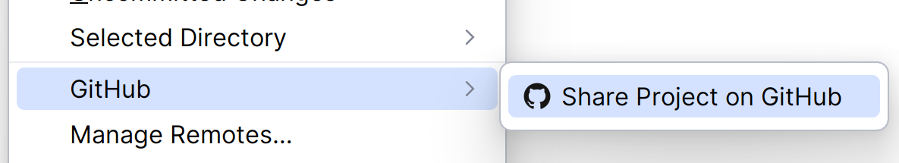
Stage 3) Sharing a Local Repository
Once the project has a git repository attached, we need to link it with a remote repository.
Allows code to be shared
Ensures code redundancy/backup
To do this, you can share the project on Github:
In IntelliJ’s Git menu

Slide 12
In Pictures: Sharing a Local Repository Online
Remote repository
Local Machine
Local repository
Working Copy (code in IDE)

Slide 13
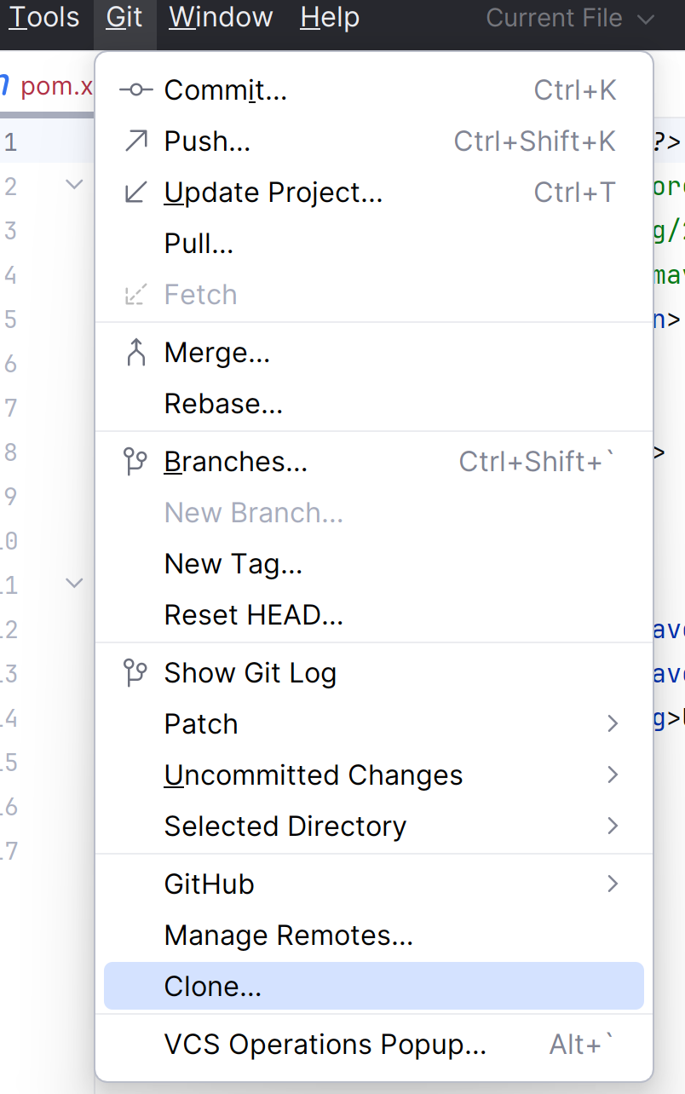
Accessing an Existing VC Project
Where a project already exists on github and you don’t have a copy on your machine, you need to clone it
Clone: Create a working copy locally so you can change and add to it
To clone an existing project, you need to:
Open the clone menu in intellij
Select the project from the list / Enter the link to the project’s remote repository

Slide 14
What Does clone Mean?
Clone sets up a new local git-tracked copy of a project
If you create a git-tracked project on your laptop, you can make a clone on your desktop
Whatever work is done in the clone can be added to the overall project
You can start writing a new method on your desktop’s project clone and it can appear* in the copy on your laptop
Notes:
*with some help! See the next few slides for how this happens

Slide 15
In Pictures: Cloning a Repository
Remote repository
After cloning, we have two separate copies connected to the same shared central repository
Original
Clone
Local repository
Local repository
IDE working copy
IDE working copy

Slide 16
Stage 2) Working on an Existing Version-Controlled Project
Once you have a working copy of a VC project, you can do any of the following basic actions:
Commit – Save the current version of your machine’s working copy into your local repository
Pull – Get an updated copy of the project from the remote repository
Push – Upload all commits not yet uploaded to the remote repository
Remote Repository
PUSH
PULL
Local Repository
COMMIT
UPDATE
Working Copy

Slide 17
Commit – Saving a Change to Your Working Copy
Once you’re satisfied you’ve finished a stage/reached a logical break, you commit the current state of the working copy to your local repository
Saving the code in your IDE saves the files in the working copy
Committing the code to the local repository stores the updates locally within the version control system
When you make a commit, you should include a commit message
Message should explain the purpose of the commit, so you can find changes easily
Note: Try not to commit broken code – you want your repository to contain functional code as much as possible

Slide 18
Committing Strategy
You might be tempted to commit large chunks at once, but don’t!
Doing this makes it harder to take advantage of many of source control’s benefits
Good committing strategy: Regularly commit small functional sections of code
Commit as you complete a logical unit (once you confirm it’s working - don’t commit broken code!)
This builds the project in a more granular manner
Can roll back small sections instead of losing “loads” of work
Can merge in changes more easily – smaller pieces to combine

Slide 19
Pull – Updating Your Working Copy With the Latest Changes
“Pulling” code from a VC project updates the working copy to match the files in the remote repository
Pull is an important action for a number of reasons:
If you are working in multiple locations
If you are working in a team
Team usage is a major motivator
Pulling the code updates your project with the work of other team members

Slide 20
Push – Uploading Your Commits to the Remote Repository
Pushing your commits uploads all your stored changes to the remote repository
Any changes you have saved in your IDE, but have not yet committed, will NOT be uploaded
Pushing:
Allows other team members update their code with your changes
Backs up the changes
Adds the changes to the history of the project

Slide 21
VCS: A Sample Work Flow
Create the project and repositories/Clone the remote repository
Write code
Commit progress to local repository
Pull updates from remote repository
Push code to remote repository
You should always pull before you push, so
Pulling lets you detect conflicts
Repairing these conflicts locally before merging changes is crucial
Repeat
Notes:
You don’t need to pull if:
You are the only developer working on the project AND
You haven’t committed changes to the repository in other locations.

Slide 22
Conflicts – A Wrinkle in Team Work
When sharing a code base, team members will inevitably change sections of code that others are also working on
Where the code is compatible, the VCS merges the different versions together
Where the code is not compatible, a conflict occurs
Conflict: Two different users push code that has edited the same line in a file.
The problem: Which should the VCS use?
Conflicts are solved through manual intervention
User pushing conflicting code assesses what the best solution is

Slide 23
Bonus Feature: Viewing Differences
An extra feature outside of the core three is diff
Diff lets you see the differences between the current version of your code and:
The local repository, i.e. to the last commit (diff to HEAD)
The remote repository (diff to repository HEAD)
Diffing to the local repository is useful to see what you have done in a file since you last committed, e.g.:
If you have been away
If you have been working on another project
Diffing to the remote repository is useful to see what other team members have added since you last pulled
Early warning if the new features might impact what you’re working on

Slide 24
Beyond Commit, Push and Pull
This is only the start of working with version control systems
There are many other features available
The next areas we’ll look at are merging and branching
Merging: Combining your new changes with the existing project
Where multiple team members are pushing changes, this is a common action!
Branching: Creating a duplicate remote repository of the original that is still linked to the original – like branches off a tree trunk
Team members can create their own branches to work in, then merge them together to create larger features and fixes

